Slide 1
Everybody Dance Now

Slide 2
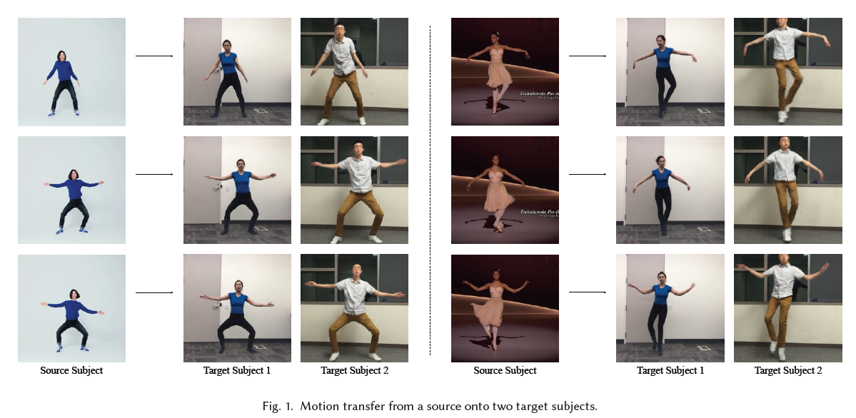
Motivation

Slide 3
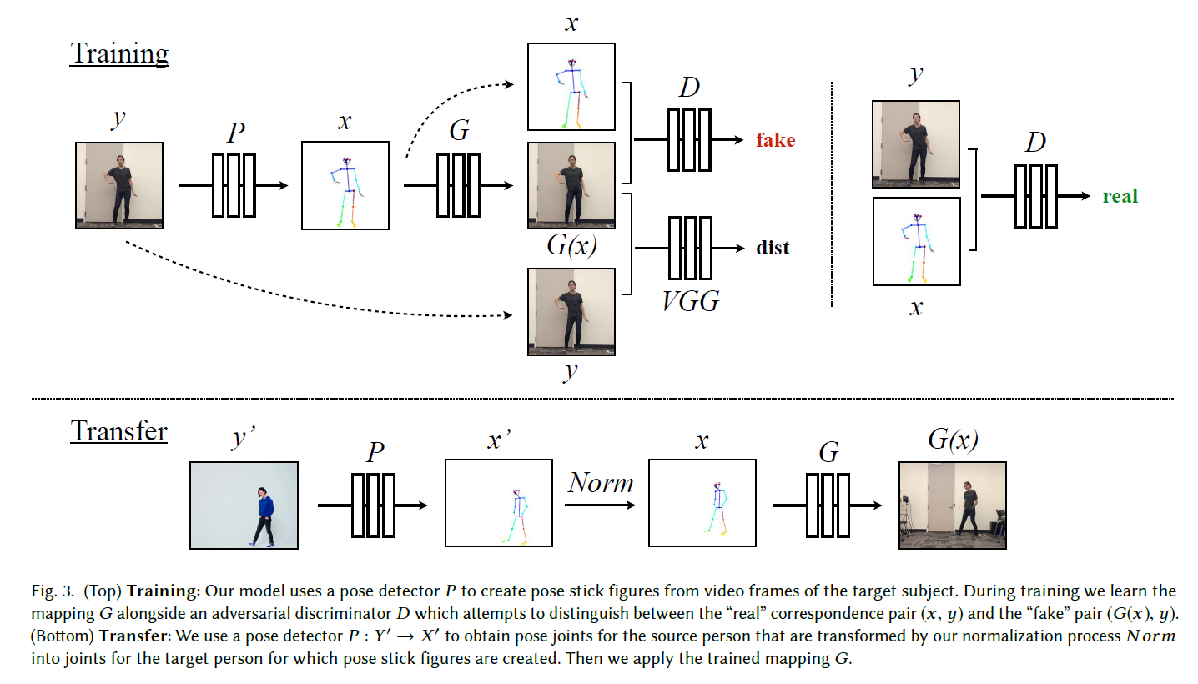
Method Overview

Slide 4
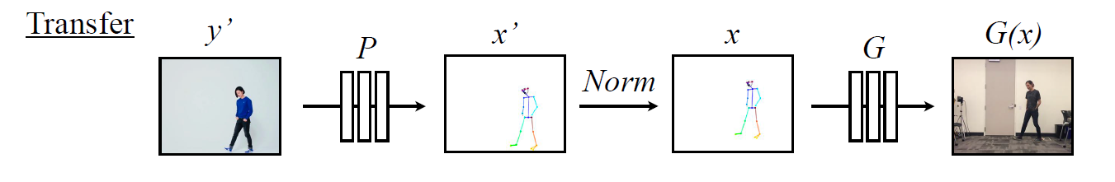
Global Pose Normalization

Slide 5
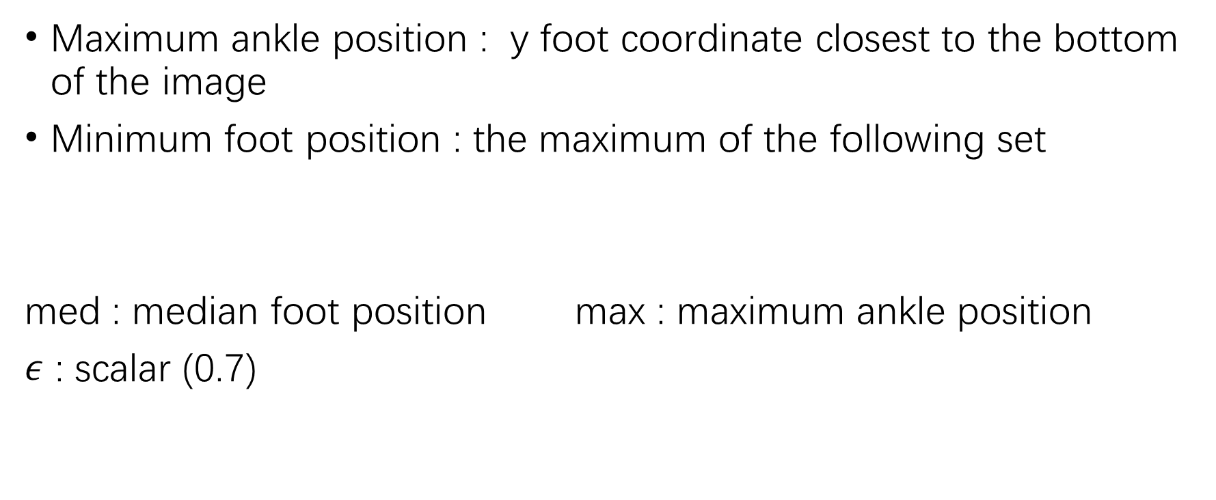
Global Pose Normalization
Maximum ankle position : y foot coordinate closest to the bottom of the image
Minimum foot position : the maximum of the following set
med : median foot position max : maximum ankle position
$ε$ : scalar (0.7)

Slide 6
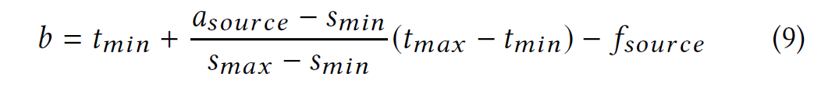
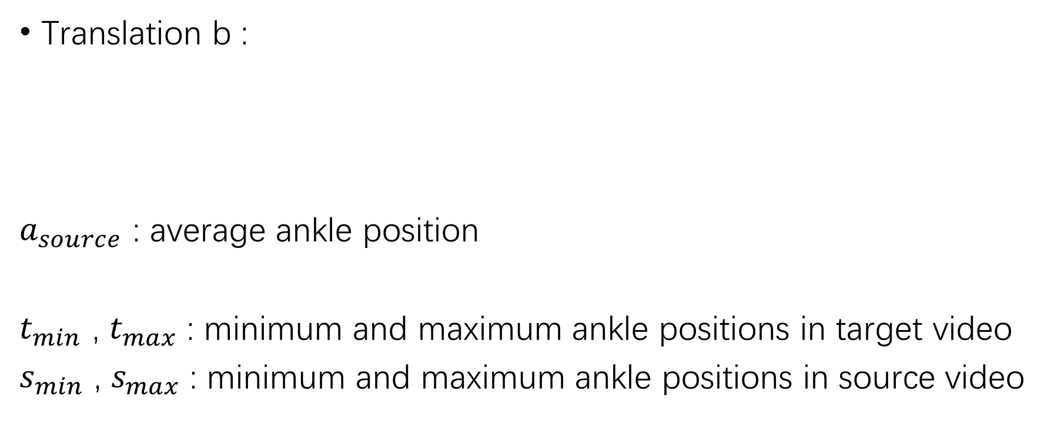
Global Pose Normalization
Translation b :
$a_{source}$ : average ankle position
$t_{min}$ , $t_{max}$ : minimum and maximum ankle positions in target video
$s_{min}$ , $s_{max}$ : minimum and maximum ankle positions in source video

Slide 7


Global Pose Normalization
Scale
$t$: target , s : source
$t_{close}$ : the maximum of the cluster near the maximum ankle position
$t_{far}$ : the maximum of the cluster near the minimum ankle position

Slide 8
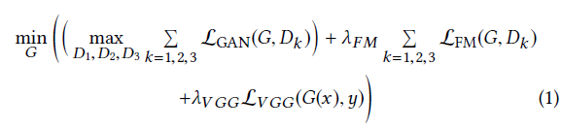
Objective presented in pix2pixHD

Slide 9
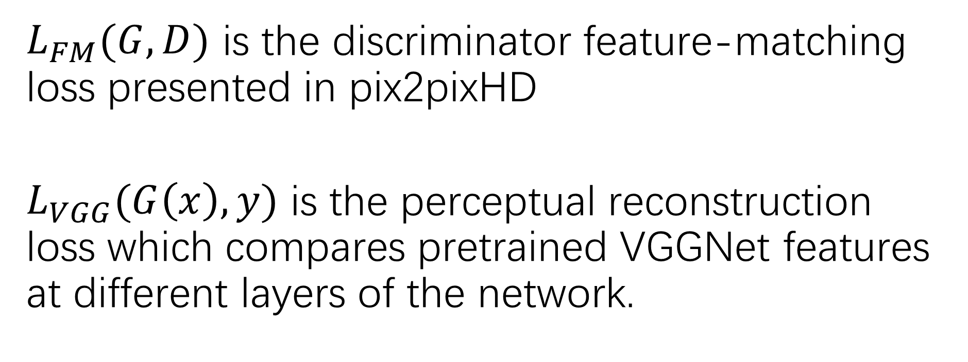
$L_{FM}(G,D)$ is the discriminator feature-matching loss presented in pix2pixHD
$L_{VGG}(G\left(x\right),y)$ is the perceptual reconstruction loss which compares pretrained VGGNet features at different layers of the network.

Slide 10
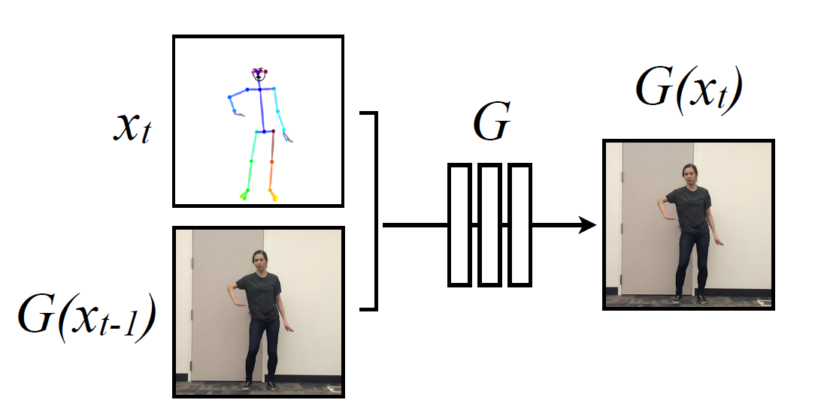
Temporal smoothing

Slide 11
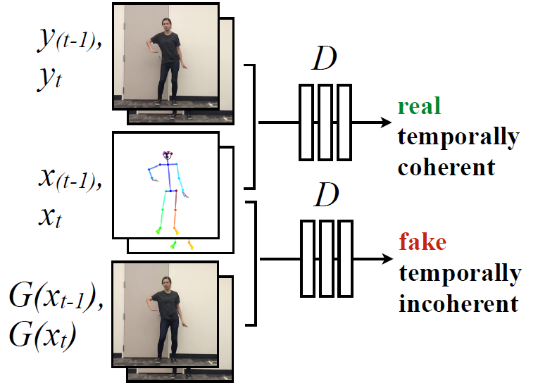
Temporal smoothing

Slide 12
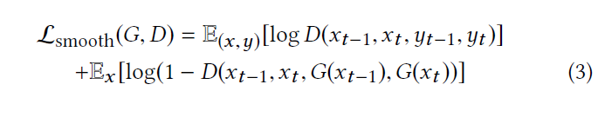
Temporal smoothing : objective

Slide 13
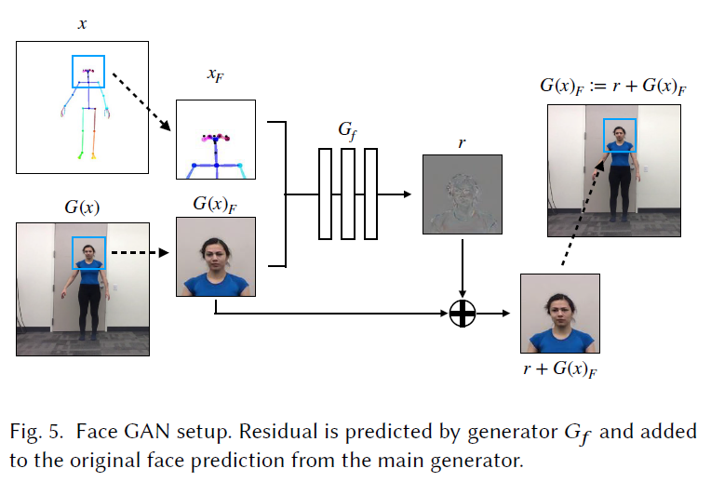
Face GAN

Slide 14
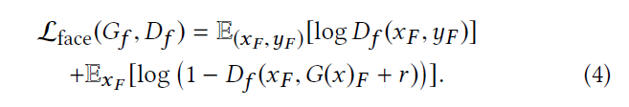
Face GAN : objective

Slide 15
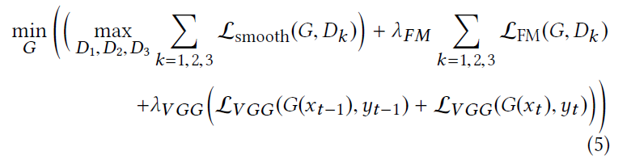
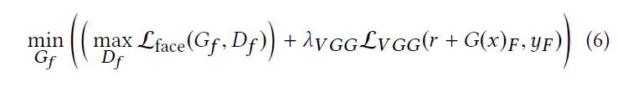
Full Objective

Slide 16
Data Collection
Target subject :
实时拍摄20分钟左右的120fps的视频；
目标人物穿着尽量少皱褶的衣服(Since our pose representation does not encode information about clothes, we had our target subjects wear tight clothing with minimal wrinkling)；
Source subject:
网络上高质量的舞蹈视频

Slide 17
Summary
Temporal smoothing
Face GAN
Jittering
One by one training
Restrictions on data

Slide 18
Thanks

